Slide 1
Get a paper from the front and answer the warm-up questions at the top
Which element makes life possible?
What is the difference between a monomer and a polymer?
What is a carbohydrate monomer called?
What is a carbohydrate polymer called?
What is a lipid monomer called? (hint: we wrote down a few in our notes)
What is a lipid polymer called? (hint: check video question 4)

Slide 2
Let’s talk about the answers now
Which element makes life possible?
What is the difference between a monomer and a polymer?
What is a carbohydrate monomer called?
What is a carbohydrate polymer called?
What is a lipid monomer called? (hint: we wrote down a few in our notes)
What is a lipid polymer called? (hint: check video question 4)

Slide 3
Check your answers
Carbon makes all life possible.
A monomer is a subunit, and many monomers can make up a polymer. Monomers are small and polymers are bigger.
A carbohydrate monomer is a monosaccharide.
A carbohydrate polymer is a polysaccharide.
Fatty Acid chains (with glycerol), phospholipids, and cholesterol
One example of a lipid polymer is called a triglyceride.

Slide 4
Time to go over proteins and nucleic acids.

Slide 5
Nucleic Acids
Nucleic Acids are made of nucleotides.
These are composed of three parts:
Sugar (Made of C,H,O)
Nitrogenous Base (Made of C, H,O, N)
Phosphate (P)

Slide 6
Nucleotides

Slide 7
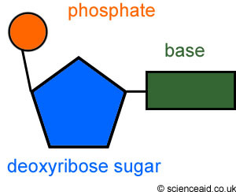
Nucleotide (the monomer)

Slide 8
Nucleic Acids
Monomer: Nucleotides
There are two types of Polymers:
Deoxyribose nucleic acid: (DNA)
Double chained found in all cells
Ribose Nucleic Acid : (RNA)
Single stranded chain in cells used to make proteins.

Slide 9
Nucleic Acids
Functions:
DNA makes up Genes. These determine traits, such as hair color or eye color.
DNA also controls cell activity through the production of Proteins.
RNA is also used to produce proteins.

Slide 10
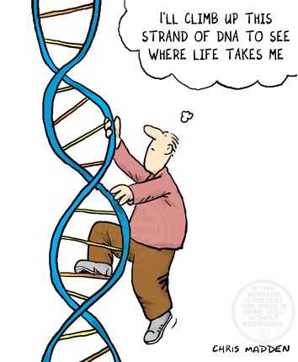

Slide 11
Proteins

Slide 12
Proteins
Proteins are made of Amino Acids
Mostly made of carbon, hydrogen, oxygen, and nitrogen. Other elements are found in side chains.
These are held together by a Peptide Bond
When these form a chain it is called a Polypeptide
Their shape determines its function (what it does).

Slide 13
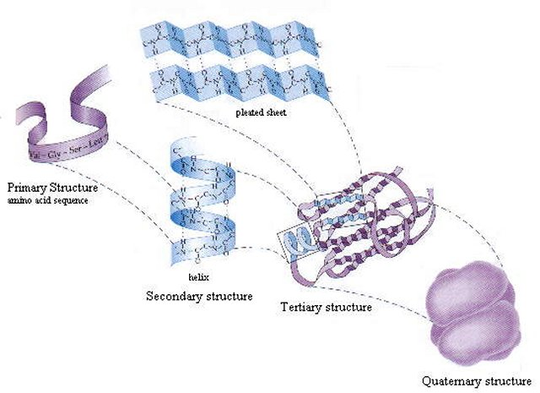
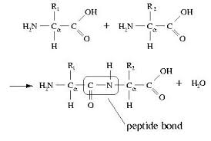
Proteins

Slide 14
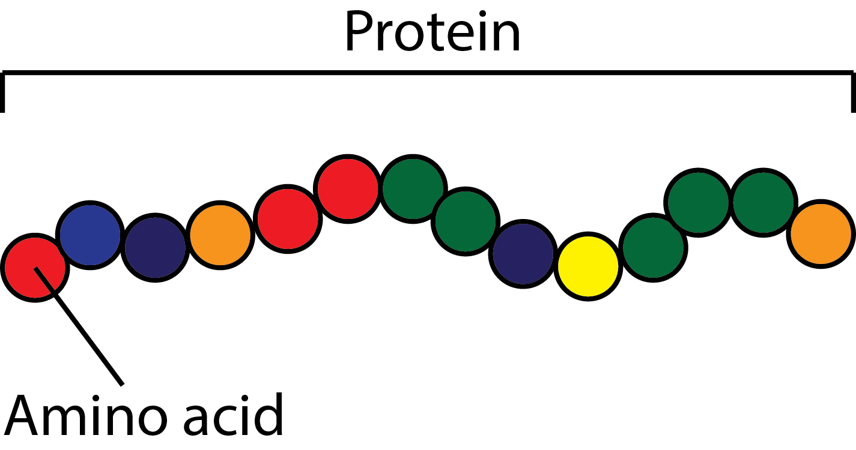

Slide 15
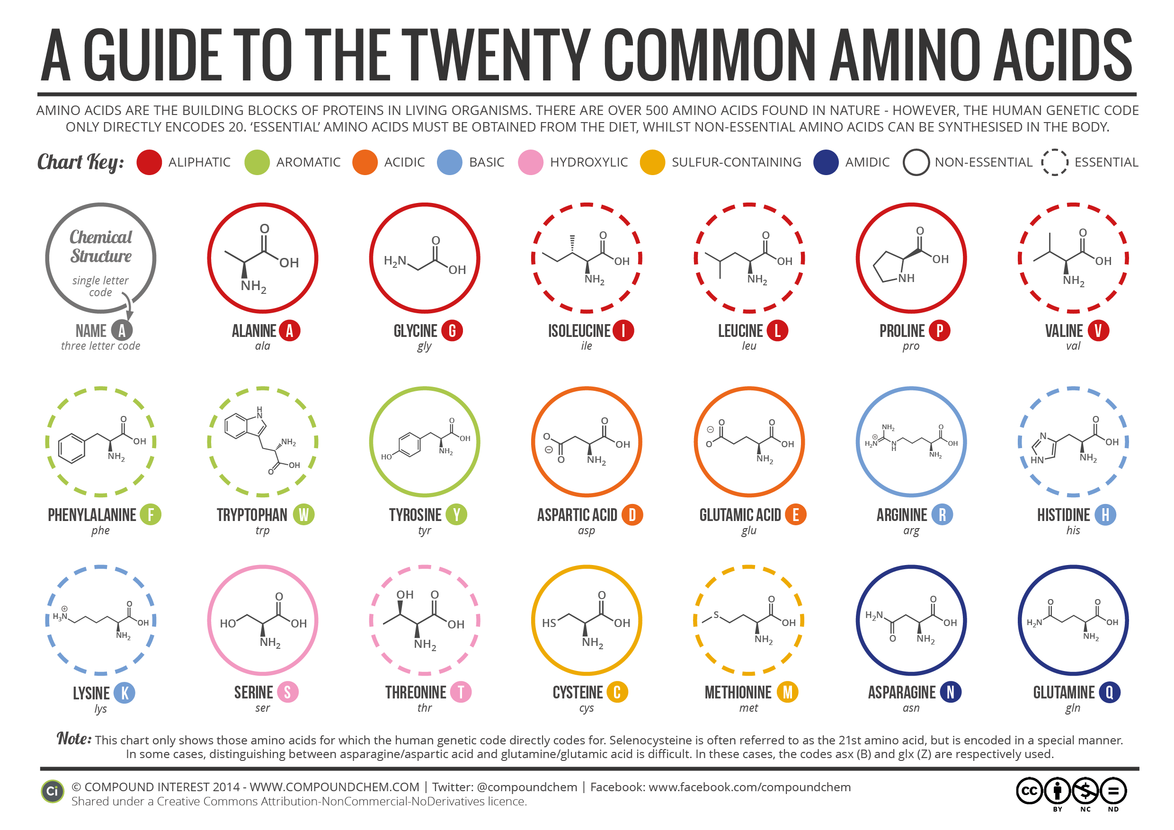
How many amino acids are there? 20 common, 22 total

Slide 16
Proteins
Monomer: Amino Acids
Functions:
Structural
Keratin
Collagen
Functional
Enzymes
Antibodies
Transport
Communication
Hormones

Slide 17
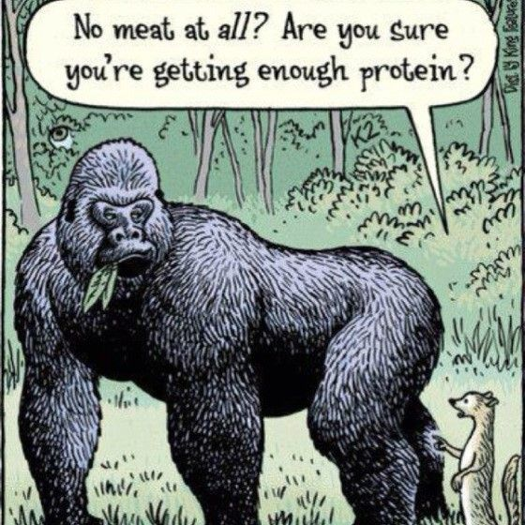

Slide 18
Let’s flip our papers over to fill in the macromolecule When you finish filling in your chart, raise your hand!

Slide 19
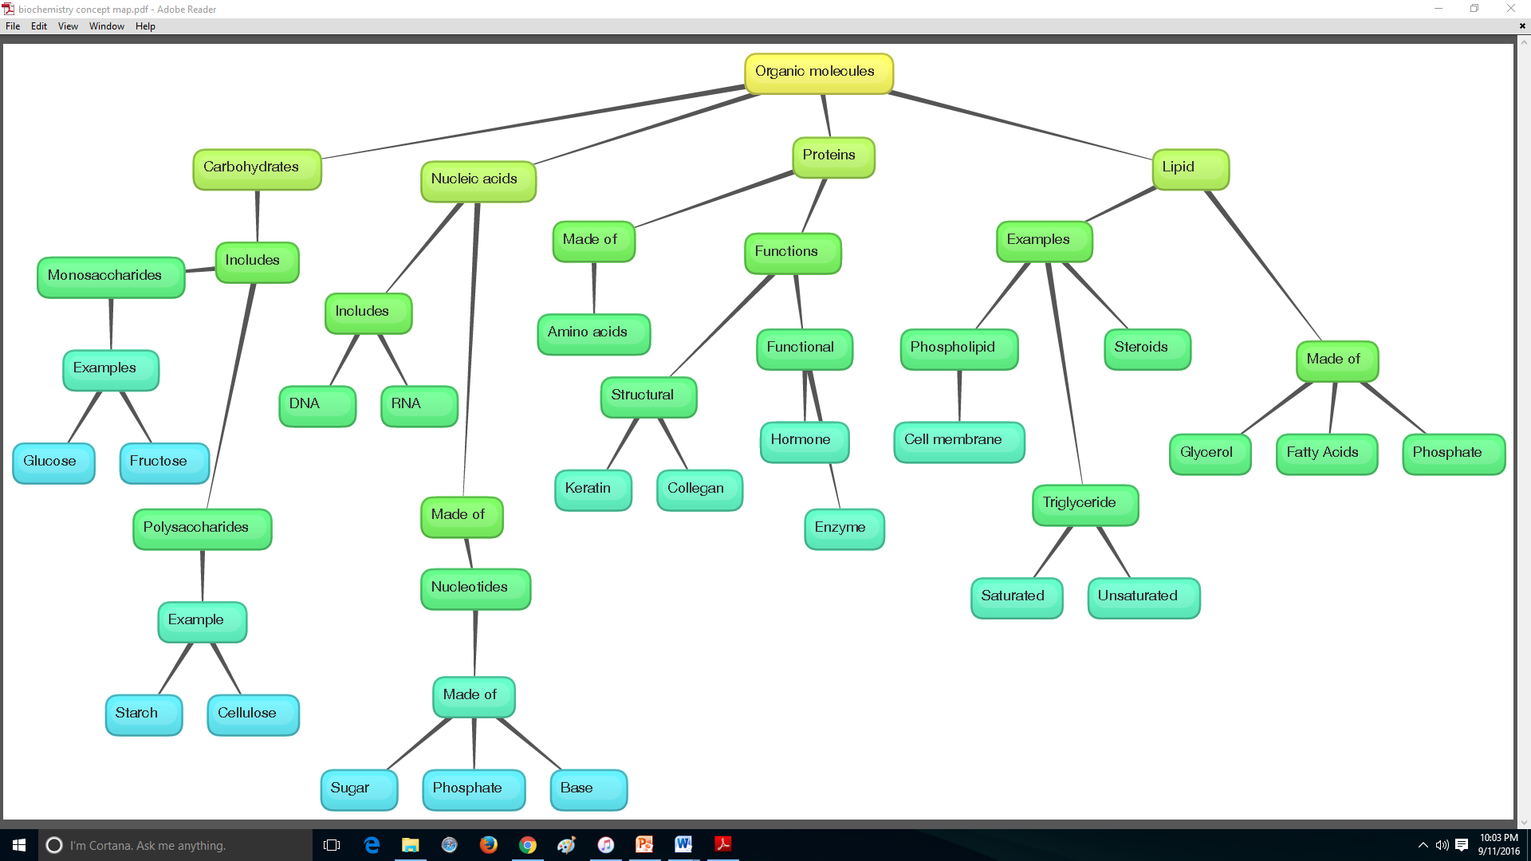

Slide 20
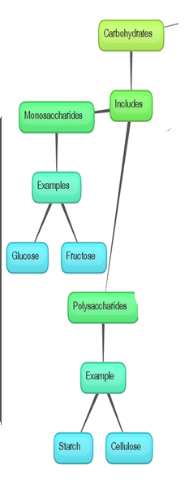

Slide 21
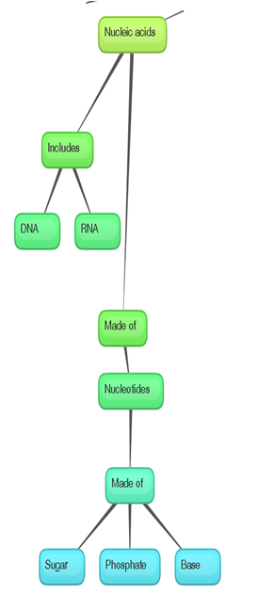

Slide 22
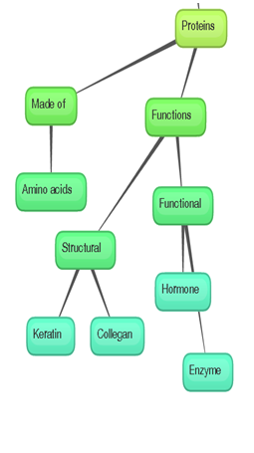

Slide 23
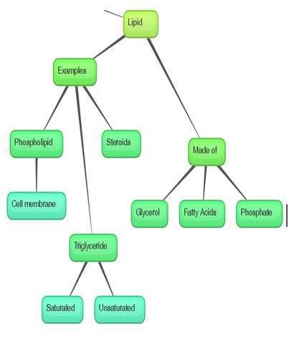

Slide 24
Macromolecules Comparison Table First cut out and put the pieces in the right place, have Mr. Shimko check your answers before you glue them down

Slide 25
Socrative Quiz
Get your Chromebook and login
Go to Socrative.com and type in the room number 336487
Type your name with the last name first, for example Andrew Shimko should be typed “Shimko, Andrew”
You can take the quiz 2 times. When you finish, get a legal size sheet of paper from the front.
Notes:
Biochemistry Vocab Practice Quiz on Socrative

Slide 26
Placemat activity
Procedure:
Divide your placemat into 4 sections.
Leave room at the top for a creative title
Label the sections with the following: Carbohydrates, Lipids, Nucleic Acids, and Proteins
Each section needs to have the following:
Elements Present in that macromolecule
Monomers
Examples of that macromolecule
3 Functions of that macromolecule
Drawing of the monomer AND polymer
3 pictures of food that have that macromolecule.

Slide 27
Placemat
Rubric:
Title=1 pt
Heading for each section= 8 pts
Monomers= 4 pts
Correct elements= 4 pts
Functions= 8 pts
Examples= 4 pts
Drawings= 8 pts
Pictures of food= 8 pts
Neatness and Creativity=5
Total= ______/50

Slide 28
Warm-Up: Answer these in your notebook
What is a function of carbohydrates?
What is a function of lipids?
What is a function of nucleic acids?
What is a function of proteins?
Which is bigger, a monomer or a polymer?

Slide 29
Warm-Up: Check your answers
Carbohydrates provide instant energy for organisms
Lipids can serve as communications, part of cell membranes, and can provide energy
Nucleic acids store genetic information and the directions to build proteins
Proteins provide structure (like hair and nails), and help make reactions happen (enzymes)
Polymers are bigger than monomers.

Slide 30
Time to plant our seedlings
One partner should get your bag
The other partner should get a cup (write your names on the cup)
Bring the cup to the bag of soil and put one scoop of soil in your cup
Plant your plant/ seedling in your cup of soil (not too deep, within 1 inch of the top. Make sure the soil is moist but not flooded. Put your cup in the window sill when you finish.

Slide 31
Get a practice Quiz (title is “Macromolecule Quiz”) to complete

Slide 32
Get a legal size piece of paper from the front of the room if you didn’t yesterday

Slide 33
Placemat activity
Procedure:
Divide your placemat into 4 sections.
Leave room at the top for a creative title
Label the sections with the following: Carbohydrates, Lipids, Nucleic Acids, and Proteins
Each section needs to have the following:
Elements Present:
Monomers:
Examples:
3 Functions
Drawing
3 pictures of food that have that macromolecule.

Slide 34
Placemat
Rubric:
Title=1 pt
Heading for each section= 8 pts
Monomers= 4 pts
Correct elements= 4 pts
Functions= 8 pts
Examples= 4 pts
Drawings= 8 pts
Pictures of food= 8 pts
Neatness and Creativity=5
Total= ______/50

Slide 35
When you finish with your placemat
Turn your placemat in at the front of the room
Take out your Biochemistry Vocab Chart to finish. Show Mr. Shimko when you finish so you can get credit.

