Slide 1
The Carbon Cycle
12/10/09

Slide 2
Catalyst
You turn on the tap water and fill a glass of water to drink. Your friend says “Stop! That might be dinosaur urine!” Is your friend right? Why or why not?

Slide 3
Learning Target
LT1: I can explain the flow of matter (water cycle and carbon cycle).
Agenda:
Catalyst
What does the flow of matter mean?
Global Warming Article
Carbon Cycle Diagram
Exit Slip

Slide 4
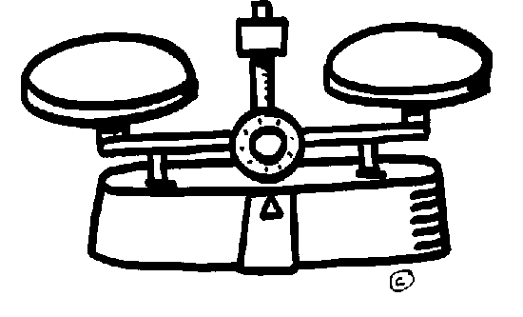
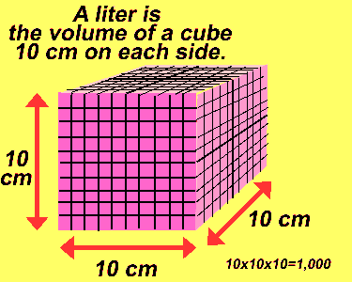
What is matter?
Matter is anything that has mass and takes up space.
Is your pencil made of matter?
Is your desk made of matter?
Are humans made of matter?

Slide 5
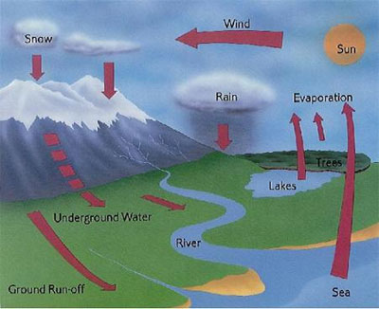
What is matter?
The Law of Conservation of Matter states that matter is not created or destroyed, only rearranged or recycled.

Slide 6
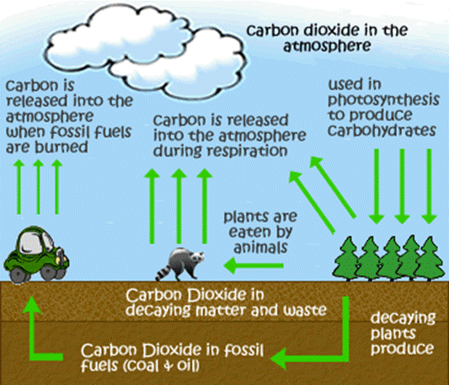
The Carbon Cycle
The Carbon Cycle is a complex series of processes through which all of the carbon atoms in the world recycle.

Slide 7
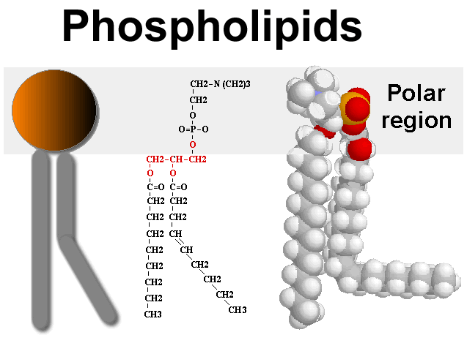
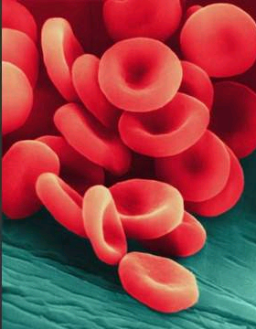
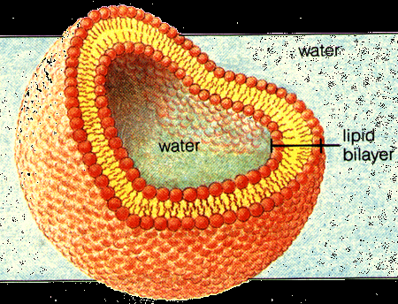
The Carbon Cycle
Carbon is important because all life on earth is based on carbon.

Slide 8
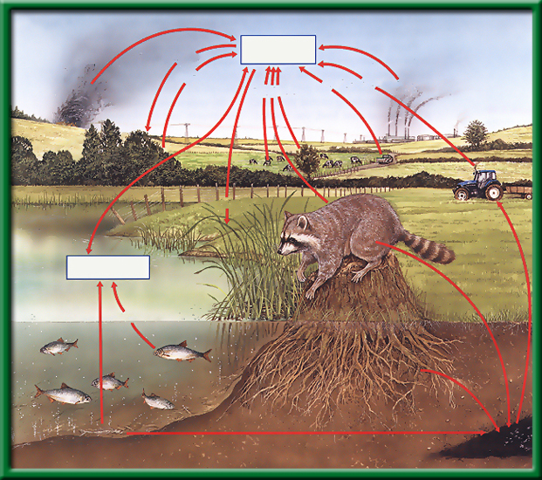
The Carbon Cycle
All life on earth is based on carbon.
Carbon is found in the atmosphere (the air) and oceans as the gas carbon dioxide (CO₂).
Open burning
Atmospheric CO₂
Photosynthesis
Respiration
Fuel Combustion
Respiration
Fuel Combustion
Photosynthesis
Dissolved CO₂
Respiration
Death and decay
Death and decay
Fossil fuels
Section 2.2 Summary – pages 46 - 57

Slide 9
Photosynthesis
CO₂ is taken out of the air by plants through photosynthesis.
Plants breathe in CO2 and breathe out O2.

Slide 10
Cellular Respiration
BOTH plants and animals release CO₂ into the air through cellular respiration
For example: Humans breathe in oxygen and breathe out CO2.

Slide 11
Photosynthesis vs. Cell Respiration
Photosynthesis
CO2
O2
Cell Respiration

Slide 12
Decomposition
Decaying plants, animals, and waste decompose after millions of years and turn into fossil fuels.

Slide 13
Human Impact
Fossil fuels can be burned by automobiles, releasing carbon back into the atmosphere.

Slide 14
Global Warming Article
How does burning fossil fuels change the carbon cycle? (It’s helpful to draw it)

Slide 15
Global Warming Article
2. What parts of the Earth have been absorbing the extra carbon?
3. How does the disruption of the carbon cycle impact the environment?
4. What is the US trying to do about it?

