Slide 1
Transgenic Organisms

Slide 2
What is a TRANSGENIC Organisms?
Let’s break apart the word:
Trans =
Genic =
Organism =
Transgenic Organisms are:
It is an organism that has had genesinserted(or moved into) from a different organism
Transgenic organisms are made from combining different DNA

Slide 3
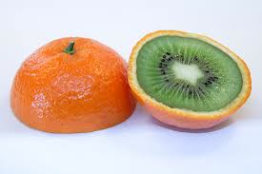
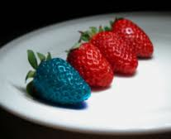
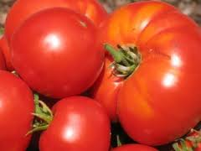
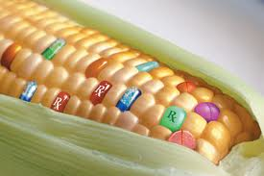
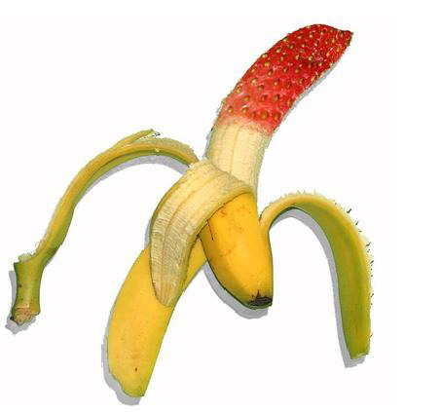
What is Genetically Modified Food (GMO)
It is a crop or food that has been intentionally modified, altered or changed.

Slide 4
What is Selective Breeding…
A type of genetic engineering
Choosing organisms (plants, animals) with the best traits (genes) and breeding them together to produce better (bigger, stronger) offspring

Slide 5
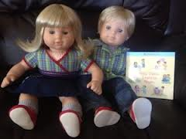
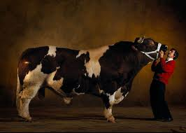
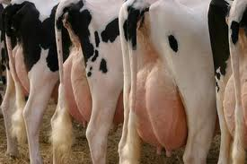
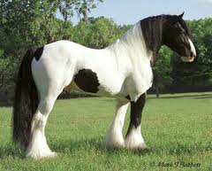
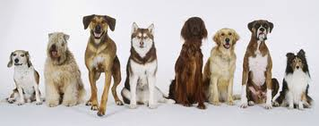
Can you thinks of a real life example of selective breeding?

Slide 6
Check Point 1
What is a Transgenic Organism?
How are transgenic organisms made?
What is a GMO?
What is a real-life example of a GMO?
What is selective breeding?
What is a real-life example of selective breeding?

Slide 7
Classical vs. Transgenic Breeding
Discussion Questions:
How do modern crops compare to their ancestors? Be SPECIFIC!
How is modern modification different from traditional breeders? Two examples.
How much of our genes do we share with plants?
How are we able to share genes with tomatoes, insects and pigs?
http://www.teachersdomain.org/resource/tdc02.sci.life.gen.breeding/

Slide 8
Transgenic Salmon: Super Salmon
Discussion Questions:
How has the Salmon Been engineered? What allows transgenic salmon to grow in the winter?
Why would a lady salmon prefer to mate with a larger salmon?
What are some possible (negative) consequences of transgenic salmon escaping form their pens into the ocean population?
How might transgenic salmon effect the evolution of other salmon populations?
Do you think the FDA should give Aqua Bounty permission to grow and sell transgenic salmon? Why or why not?
http://www.teachersdomain.org/resource/tdc02.sci.life.gen.salmon/

Slide 9
Bt Corn
Discussion Questions:
What is the pest the farmer is trying to remove? What does the pest do to the corn?
How is Bt corn different than using normal pesticides? Why is it better?
How is Full Belly farm different?
What is the downside to using Bt? What happens to the pesticides over time?
How does planting a non-Bt area help with future resistance?
http://www.teachersdomain.org/resource/tdc02.sci.life.gen.btcorn/

Slide 10
EOC Prep
Bacillus thuringiensis, a bacterium commonly known as Bt, produces a protein that can kill certain insects that feed on corn crops. Scientists have been successful in transferring the gene that codes for this protein from the bacterium to the corn, so the corn can now make the Bt protein. Corn borers, insects that eat corn, die when they feed on corn containing the Bt protein. A potential problem associated with increased production of Bt corn is
corn borers may stop feeding on corn plants
B. corn borers may develop resistance to the Bt protein
farmers may need to use less pesticide to control corn borers
corn borers may compete with other insects

Slide 11
But how does this work…?

Slide 12
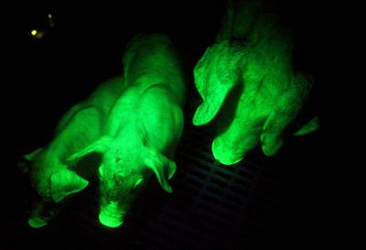
How did THIS happen?!

Slide 13
Glow-in-the-dark PIGS?!
A desired gene from one organism (the glow gene from a fire fly) was inserted into the DNA of a pig
Through MITOSIS the pig’s cells began replicating the glow-in-the-dark gene (the desired gene)
Let’s take a closer look at this…

Slide 14
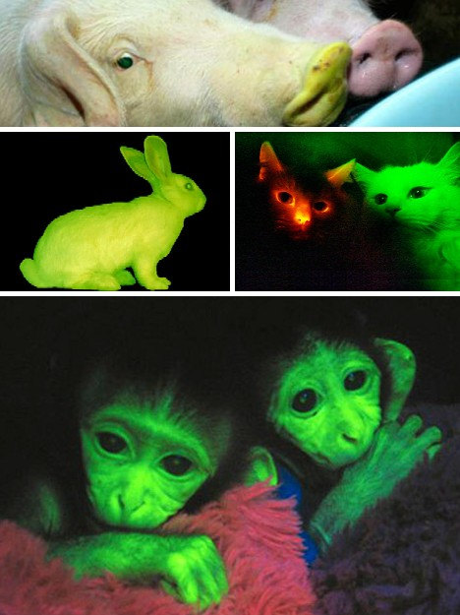

Slide 15
What is Recombinant DNA
When DNA from two different organisms come together, the DNA becomes RECOMBINANT DNA
What does recombinant (recombine) mean?
The organism that receives the recombinant DNA will use it as if it were its own DNA.

Slide 16
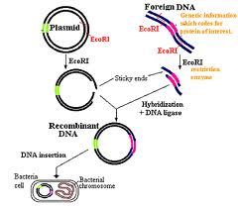

Slide 17
Also know as…
Transgenic Organisms

Slide 18
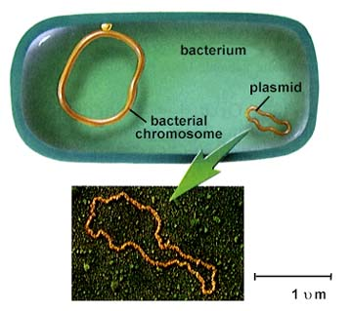
How do scientists create DNA?
Its all about using BACTERIA!
This is because bacteria have DNA rings called PLASMIDS.

Slide 19
Steps for Creating a Transgenic Organism
Remove the plasmid
Cut the bacterial DNA using restriction enzymes
Remove and cut a desired gene from a different organisms (foreign DNA)
Then glue a piece of foreign (human, plant, animal) DNA back into the plasmid using the enzyme Ligase.
Insert the plasmid back into the Bacteria
Now, the bacteria will reproduce the new gene (in the plasmid DNA) to make larger quantities of the desired gene or trait.

Slide 20
All bacteria are…
IDENTICAL
REMEMBER: bacteria divide using asexual reproduction!
SO…
Every new bacteria will be making exact copies of the desired gene!

Slide 21
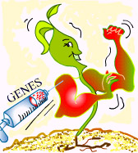
Applications of Recombinant DNA
Bacteria
used to produce hormones, antibiotics and Insulin
Plants
made to be resistant to herbicides and Pesticides
Animals
Cloning
Replacement of genes which cause disorders (aka Gene Therapy)
Such as Cystic Fibrosis
Severe Combined Immunodeficiency

Slide 22
Genetic Engineering of Insulin

Slide 24
Let’s take a look…
ttp://www.youtube.com/watch?v=AEINuCL-5wc&feature=youtube_gdata_player
http://www.youtube.com/watch?v=GNMJBMtKKWU&feature=youtube_gdata_player
http://www.youtube.com/watch?v=TpmNfv1jKuA

Slide 25
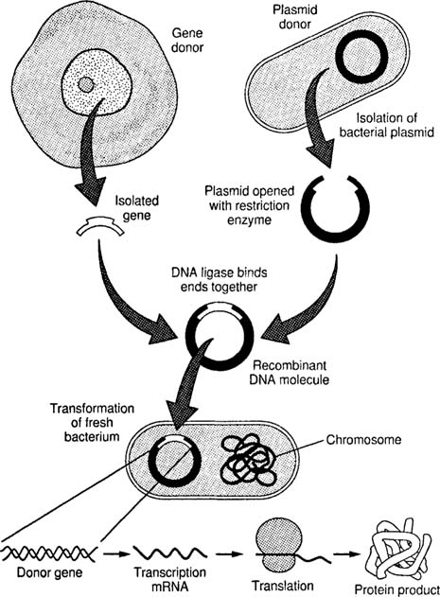

Slide 26
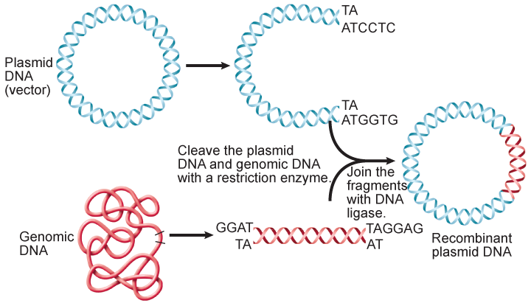
Genetics and Biotechnology

Slide 27
Genetic Engineering Re-Cap
http://www.youtube.com/watch?v=TpmNfv1jKuA

Slide 29
ONE MORE TIME!
Restriction Enzyme (like Eco R1)
Binary Fission to make lots of bacteria!
Gene (like the Insulin gene)
Human Cell
(like a pancreas cell)
Recombinant DNA
Bacterium
Plasmid
Restriction Enzyme
(like Eco R1)
Each bacterium will go through protein synthesis to make lots of human insulin!
Bacteria cell

