Slide 1
Cell Structure
Unit 2| Module 3

Slide 2
The Cell Theory
All organisms are made of cells
Plants
Animals
Cells are the structural and functional units of organisms
STERNGRR processes occur in cells!
All cells come from pre-existing cells
Cells reproduce to make more cells
Bacteria

Slide 3
ALL cells have
DNA (chromosomes)
Cytoplasm
Ribosomes
Cell membrane (aka plasma membrane)

Slide 4
Prokaryotic Cells
DNA
Cell Membrane
Ribosomes
Cytoplasm
Plasmid

Slide 5
Eukaryotic Cells – have a nucleus with chromosomes made of DNA to REGULATE cell activities

Slide 6
Both animal AND plant cells have a cell membrane / plasma membrane to regulate TRANSPORT of materials
The cytoplasm is the “filling” of the cell” (mostly water)

Slide 7
Ribosomes are the sites of protein SYNTHESIS

Slide 8
Organelles: “little organs” Carry out STERNGRR processes
Mitochondria

Slide 9
Organelles: “little organs” Carry out STERNGRR processes
Vacuoles

Slide 10
Organelles: “little organs” Carry out STERNGRR processes
Endoplasmic Reticulum

Slide 11
Organelles: “little organs” Carry out STERNGRR processes
Golgi complex

Slide 12
Organelles: “little organs” Carry out STERNGRR processes
Lysosomes
(not shown)

Slide 13
Organelles: “little organs” Carry out STERNGRR processes
centriole

Slide 14
Organelles: “little organs” Carry out STERNGRR processes
Cell wall

Slide 15
Organelles: “little organs” Carry out STERNGRR processes
Chloroplast

Slide 16
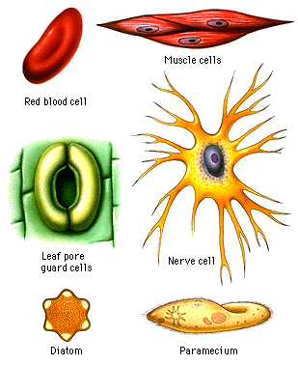
FORM RELATES TO FUNCTION
Contracts / relaxes for movement
Squeezes through tiny blood capillaries, carrying oxygen to cells
Sends messages through body
Opens/closes to regulate water and gas exchange
Single-celled aquatic organism
Single-celled aquatic organism

