Slide 1
Microscopy

Slide 2
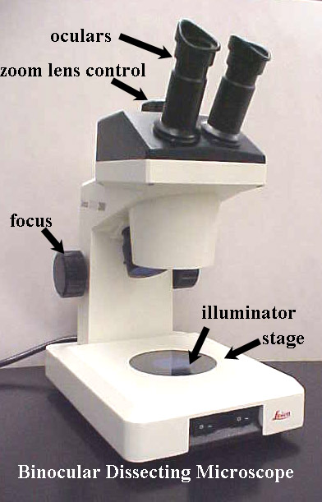
Dissecting Microscope – Uses two oculars. Low Magnification

Slide 3
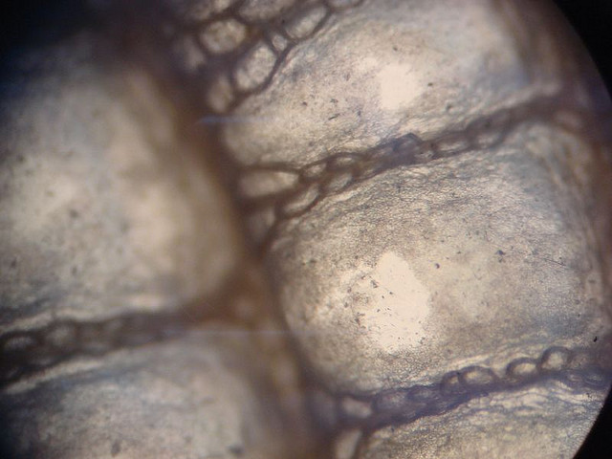

Slide 4
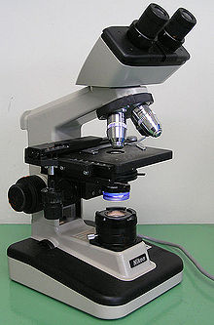
Compound Light Microscope: Single Ocular Medium magnification

Slide 5
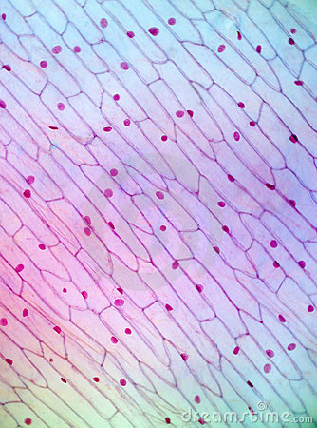

Slide 6
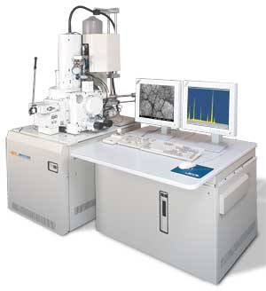
SEM – Scanning Electron Microscope Very High Magnification

Slide 7
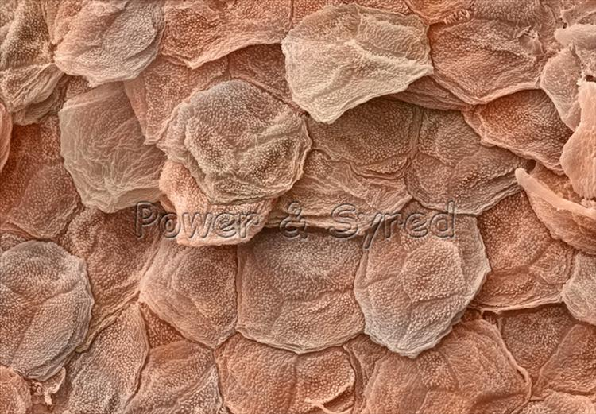

Slide 8
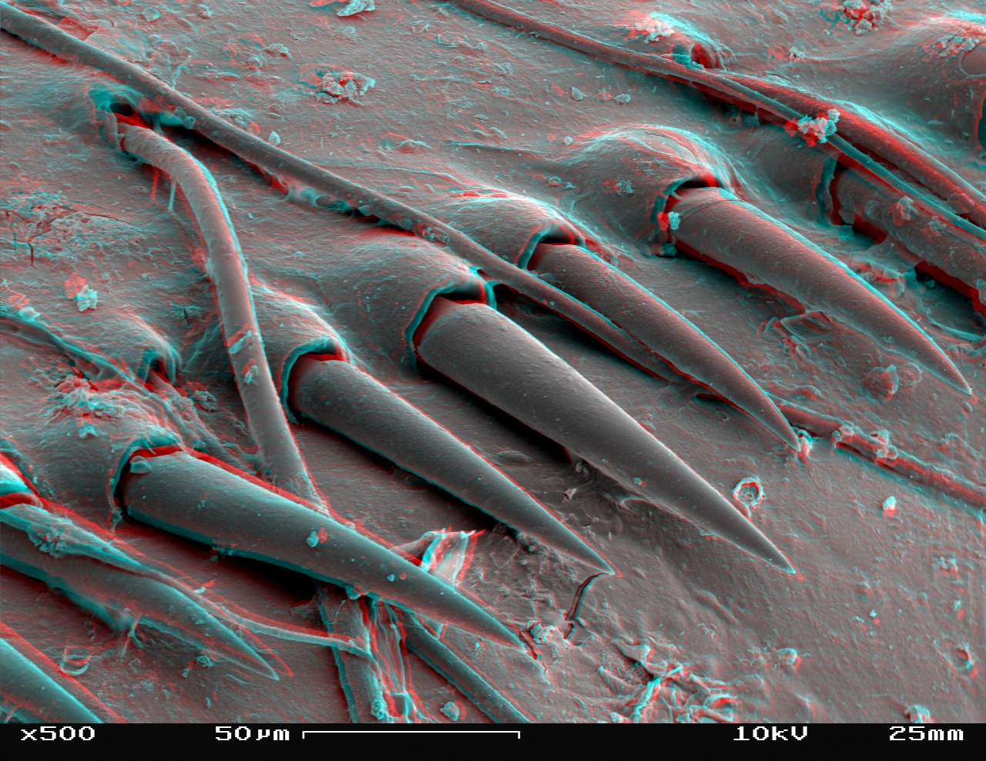

Slide 9
