Slide 1
The Nitrogen Cycle
12/12/2009

Slide 2
Catalyst
Is gasoline made out of dead animals?
Is the CO2 that you breathe made from skin cells?
Is air (O2 + CO2 +N2) made of matter?
Remember to turn in your Catalyst at the end of the day today!

Slide 3
Learning Target
I can explain the flow of matter (water, carbon and nitrogen cycles)
Agenda
Catalyst
What is the Nitrogen Cycle?
Acid rain
Independent Practice
Exit Slip

Slide 4
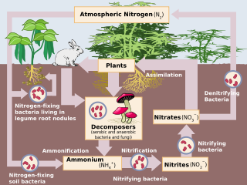
The Nitrogen Cycle
The nitrogen cycle shows how nitrogen is recycled throughout the environment.

Slide 5
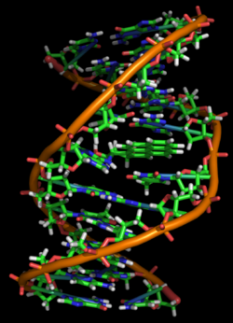
Why is the nitrogen important?
protein
Nitrogen is important because it makes
amino acids and
nucleic acids.
DNA

Slide 6
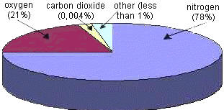
Why is nitrogen important?
There is also a lot of nitrogen gas (N2) in the air but plants and animals can’t use it!
80% of the Earth’s atmosphere is nitrogen gas (N2)

Slide 7
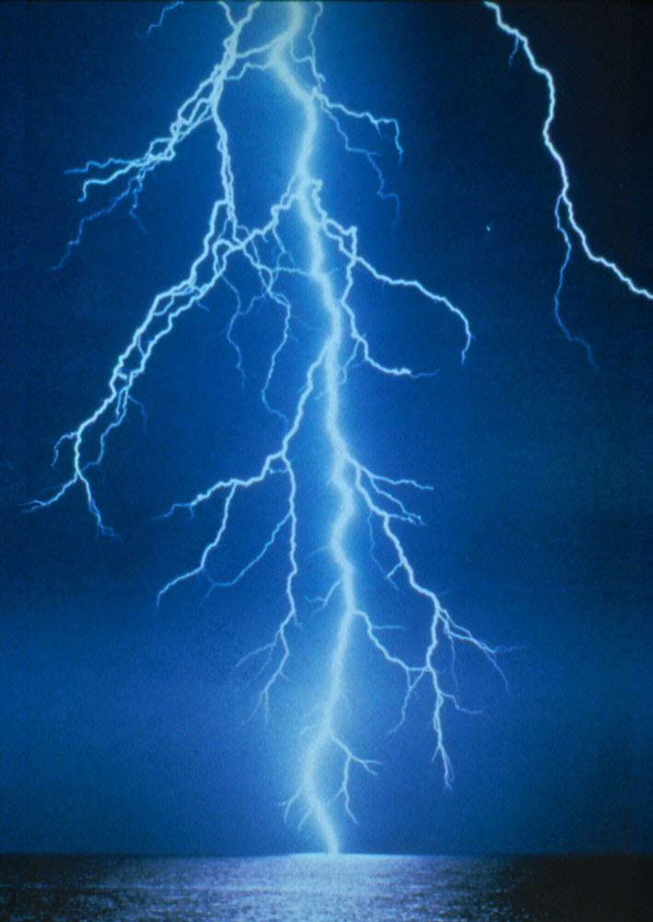
The Nitrogen Cycle
Nitrogen gas (N2) must be broken down by lightning, fire, or bacteria before plants & animals can use it.

Slide 8
The Nitrogen Cycle
There are four forms of Nitrogen.
Nitrogen gas (N2)
Nitrite (NO₂⁻)
Nitrate (NO₃⁻ )
Ammonium ion (NH₄⁺ )
Plants and animals can only take in nitrate and ammonia

Slide 9
Nitrification
To use the nitrogen, bacteria “fix” nitrogen from the air for the plants = called nitrogen fixation
Bacteria, that live on the roots of some plants, change nitrogen into ammonia, a form of nitrogen plants can use.

Slide 10
Denitrification
Denitrification is when bacteria recycle nitrogen back to the atmosphere.
Ammonia in the soil is converted back into nitrogen gas

Slide 11
Assimilation
Assimilation is when plants take in ammonia or nitrate.

Slide 12
The Nitrogen Cycle
Animals get nitrogen by eating plants.
All nitrogen obtained by animals can be traced back to the eating of plants at some stage of the food chain.

Slide 13
Ammonification
When plants and animals die, their bodies decompose and release ammonia back into the soil for plants to use.

Slide 14
Human Impact
Burning fossil fuels and wood contributes to a large amount of nitric oxide in the atmosphere.
Nitric oxide can combine with oxygen gas to for nitrogen dioxide, which reacts with water vapor to form a strong acid (nitric acid). This can precipitate out of the atmosphere in the form of the deadly acid rain. The acid can damage trees and kill fish.

Slide 15
Acid Rain
Define acid rain
Explain the pH difference between acid rain and pure water
Describe the major cause of acid rain
Why is acid rain of particular interest?
What are the main chemicals in air pollution that create acid rain?

Slide 16
Acid Rain
6. How long does the chemical reactions take that change air pollution to acid rain?
7. What did the US government do at first to reduce the pollution from smokestacks?
8. How successful was this government action?
9. Which region of the Continental US. Is most affected by acid rain?
10. Which region is the least affected by acid rain?

Slide 17
Independent Practice
Word Bank: oceans, Proteins, organisms, Amino Acids, bacteria, soil, fertilizer, tissues, nitrogen, atmosphere.
All organisms need Nitrogen to make 1) _ _ _ _ _ _ _ _ _ _, the building blocks of 2) _ _ _ _ _ _ _ _.
Nitrogen is found:
In the 3) _ _ _ _ _ _ _ _ _ _ as N₂ gas - the main reservoir;
In 4) _ _ _ _ - as nitrate ions (NO₃⁻), nitrite ions (NO₂⁻) and ammonia (NH₃);
The 5) _ _ _ _ _ _ _ of living things as 6) _ _ _ _ _ _ _ _;
And also in the 7) _ _ _ _ _ _ and other large bodies of water in various forms.
Human activity adds 8) _ _ _ _ _ _ _ _ to the biosphere in the form of nitrate – a major component of 9) _ _ _ _ _ _ _ _ _ _.
Amino Acids
Proteins
atmosphere
Ions
tissues
Organisms
Oceans
Nitrogen
fertilizer

Slide 18
Independent Practice
Where are the sources of nitrogen gas?
What organisms are responsible for converting the ammonium into nitrite and nitrate?
What processes are at work below ground in the nitrogen cycle?

Slide 19
Independent Practice
4. Where is nitrification occurring?
5. Where is denitrification occurring?
6. Where is assimilation occurring?
7. Where is decomposition occurring in this picture?

